Slide 1
EARLY DETECTION OF CHRONIC KIDNEY DISEASES USING MACHINE LEARNING

Slide 2
INTRODUCTION: Chronic kidney disease is reffered as CKD. As past record the number of death in India due to CKD were 5.21 million in 2008 and further raised to 7.63 million by 2020. There is need of detection of chronic kidney Diseases at early stage before it get worse To reduce mortality rate ,an efficient technic to pretict the diseases
Notes:
Chronic kidney disease is reffered as CKD.

Slide 3
Materials and Methods:
Diastolic Blood Pressure (Bp - mmHg) [39]: This feature shows the participator’sdiastolic blood pressure
Specific Gravity (Sg) [40]: This feature captures the participator’s specific gravityvalue.
Albumin (Al) [41]: This attribute captures the participator’s albumin level.
It hasthree categories (72.25% normal, 21.5% above normal and 6.25% well above normal)
Glucose (Su) [42]: This attribute denotes the participator’s glucose level.
It has threecategories (88% normal, 8% above normal and 4% well above normal)

Slide 4
Sodium (Sod - mEq/L) [46]: This feature measures the amount of sodium found in the participant’s blood. Sodium is a type of electrolyte and is reported as milliequivalents per liter (mEq/L Hypertension (Htn) [50]: This attribute refers to whether the participant has hypertension or not.

Slide 5
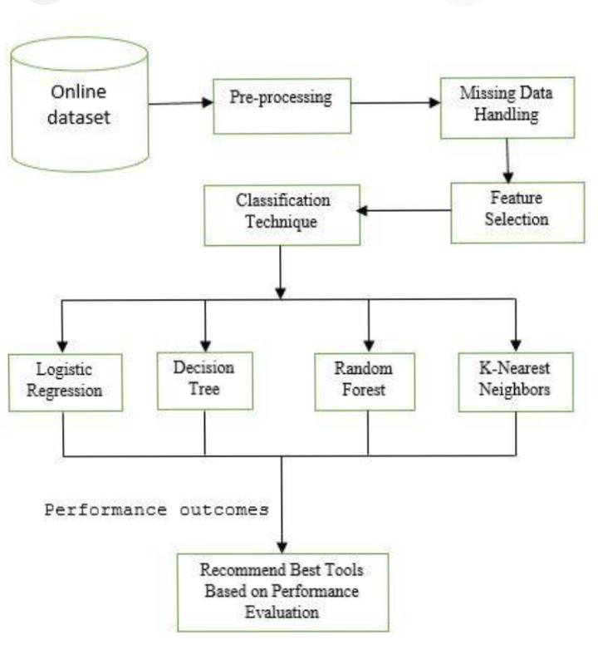
Data Processing:

Slide 6
Chronic Kidney Disease Risk Prediction:
In this section, we will focus on class balancing and features importance evaluation inthe balanced data. We will also make a brief analysis of the nominal features concerningthe CKD class. Moreover, we will describe the models and performance metrics, which
will be considered in the experiment

Slide 7
Machine learning model: In this subsection, we will make a brief presentation of the models that will be considered in the risk prediction framework for CKD occurrence.

Slide 8
Random Forest: Random Forest is an ensemble of decision trees. It considers the Information Gain or Gini index to find the best subset of features. It classifies an instance by applying majority voting on the outputs of several decision trees [64].

Slide 9
Random Tree Random Tree [65] ensembles several decision trees. It partitions recursively the training data into segments with similar output features’ values and finds the best partition assessing the impurity index

Slide 10
Ensemble Learning Ensemble learning is utilized in machine learning to obtain more accurate predictionsthan individual models by combining the outputs of several single classification models. Voting and Stacking are the two methods which will be used in this study.abel [71]demonstrate the above-mentioned

Slide 11
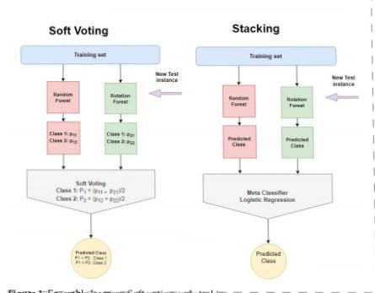
Soft voting and Stacking:

Slide 12
Evaluation Metrics: Specifically, accuracy summarizes the performance of the classification task and measures the number of correctly predicted instances out of all the data instances. Precision =TP/TP + FP Recall =TP/TP + FN F − Measure = 2Precision Recall/Precision+Recall Accuracy =TN + TP/TN + TP + FN + FP

Slide 13
Conclusions: Chronic kidney disease is a condition characterized by progressive loss of kidney function over time. It is a silent disease, as most sufferers have no symptoms. Early diagnosis and treatment of CKD is a serious task for the medical community that resorts toML theory to design an efficient solution to this challenge.

Slide 14
Reference: Mahadevan, V. Anatomy of the kidney and ureter. Surgery 2019, 37, 359–364. [CrossRef] Levey, A.S.; Coresh, J. Chronic kidney disease. Lancet 2012, 379, 165–180. [CrossRef] Koye, D.N.; Magliano, D.J.; Nelson, R.G.; Pavkov, M.E. The global epidemiology of diabetes and kidney disease. Adv. Chronic Kidney Dis. 2018, 25, 121–132. [CrossRef]

